Slide 1
Rx Learning
2 scenarios:
Template learning - 3bit/real
Correlation learning (end-to-end)
collection of 1 pixel data:
500-4000mm
16,32 & 64 code
with and without ND filter

Slide 2
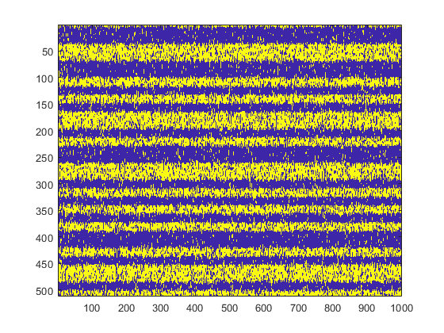
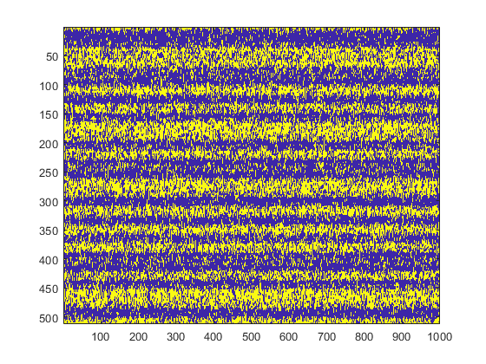
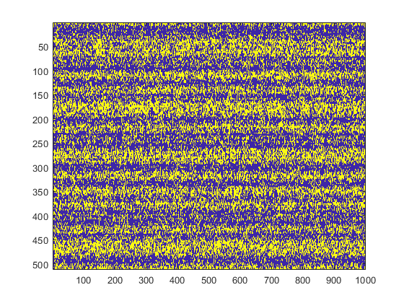
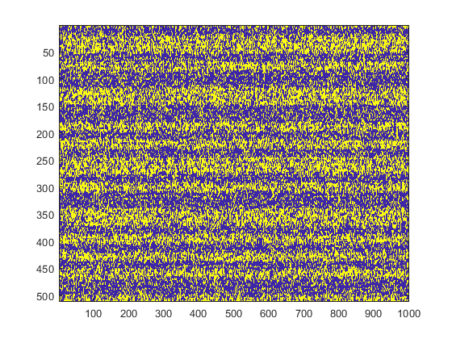
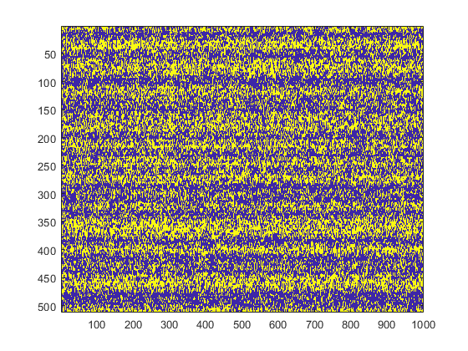
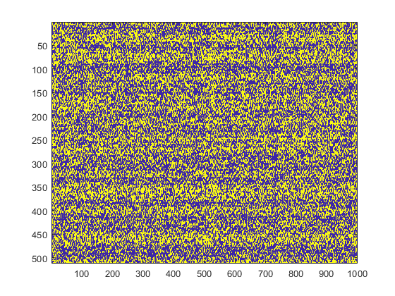
ND - 0.5
ND - 0.25
2000mm
3500mm

Slide 3
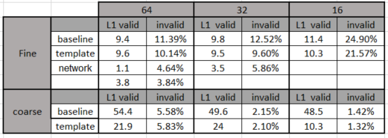
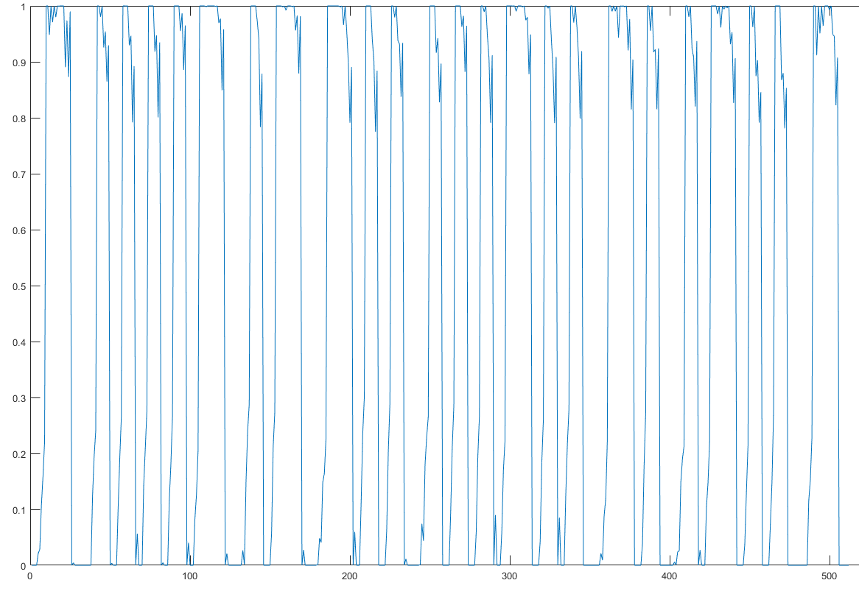
Rx Learning
Only fine/coarse template
Combined fine & coarse – similar results, didn’t tested it for must of the cases
3bit – slight degraded results
3bit learning ~= real learning&quantization

Slide 4
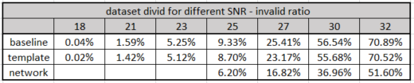
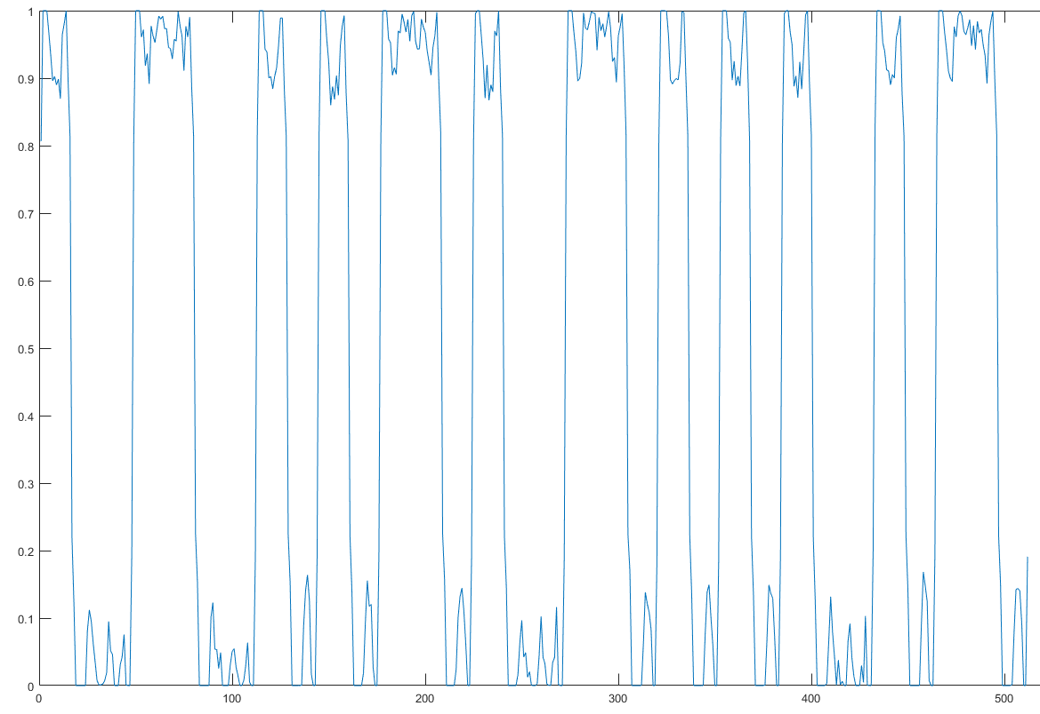
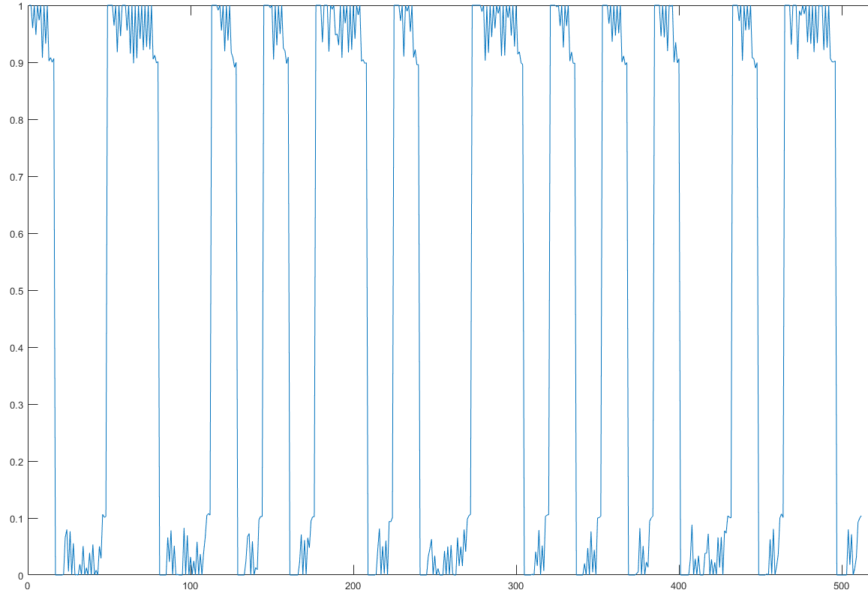
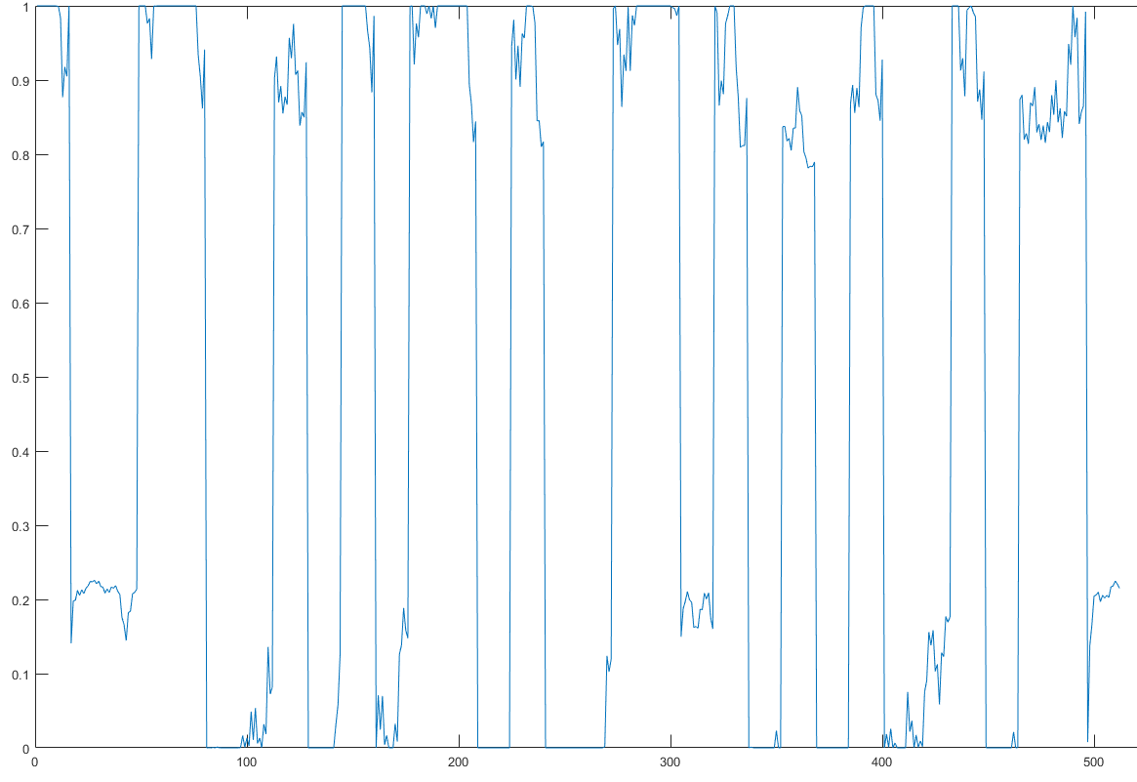
Rx Learning – PSNR data split

Slide 5
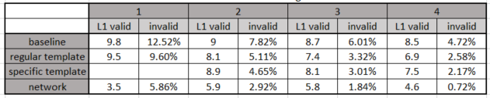
Rx Learning - Averaging samples

Slide 6
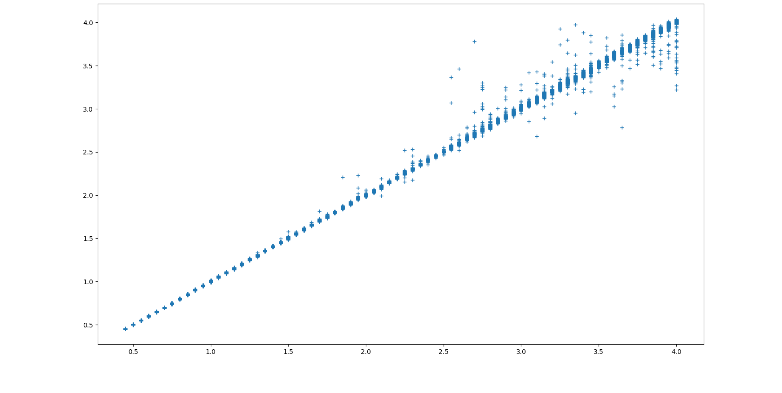
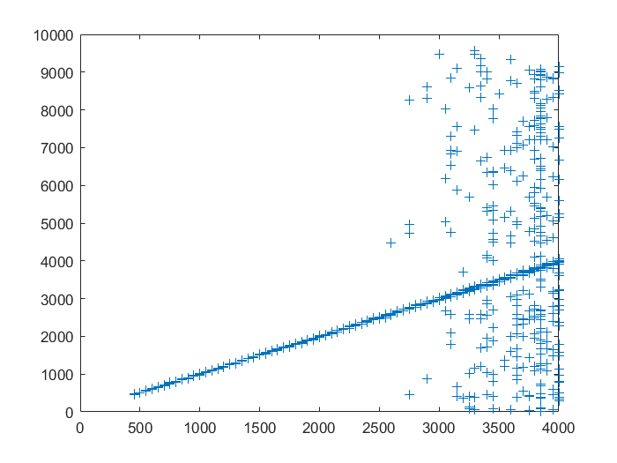
Rx Learning – end-to-end network
Fine learning : Z estimation
Full cor : Z estimation
GT distance [m]
GT distance [mm]
Further research:
Optimal network architecture for given hardware constraints

Slide 7
Rx - General
Different loss function for optimize invalid ratio

Slide 8
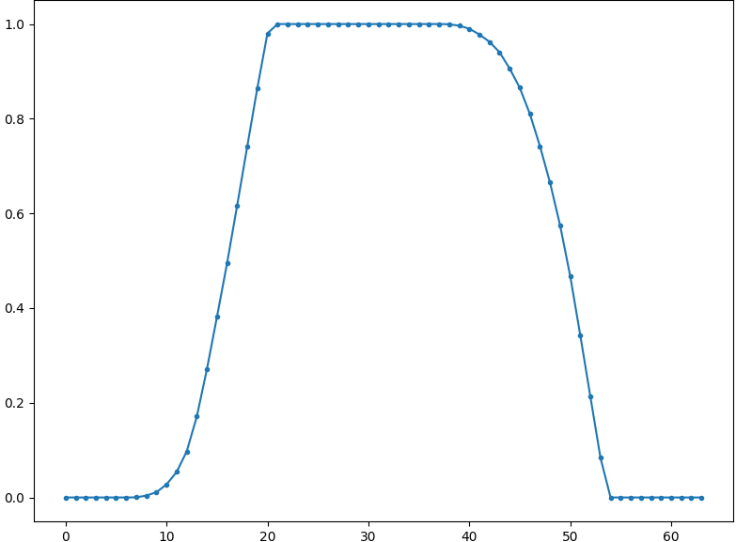
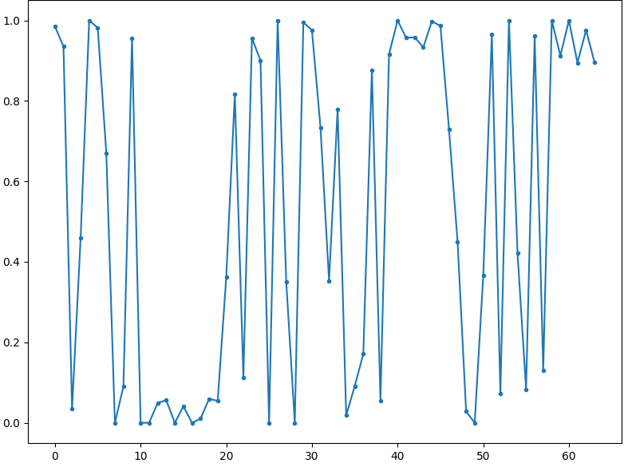
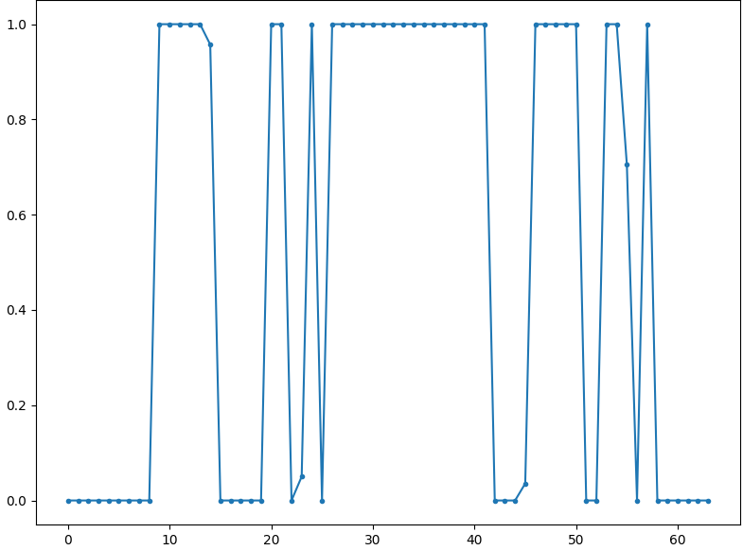
Tx Learning
Same pipeline – fine&coarse
w/o data – simulated data
Can choose learn Tx code/Rx template/both
Simulated data – don’t look like the real data
Inaccurate simulator
Inaccurate parameters
Emulate data?
Simulator
Flip noise
Additive noise

Slide 9
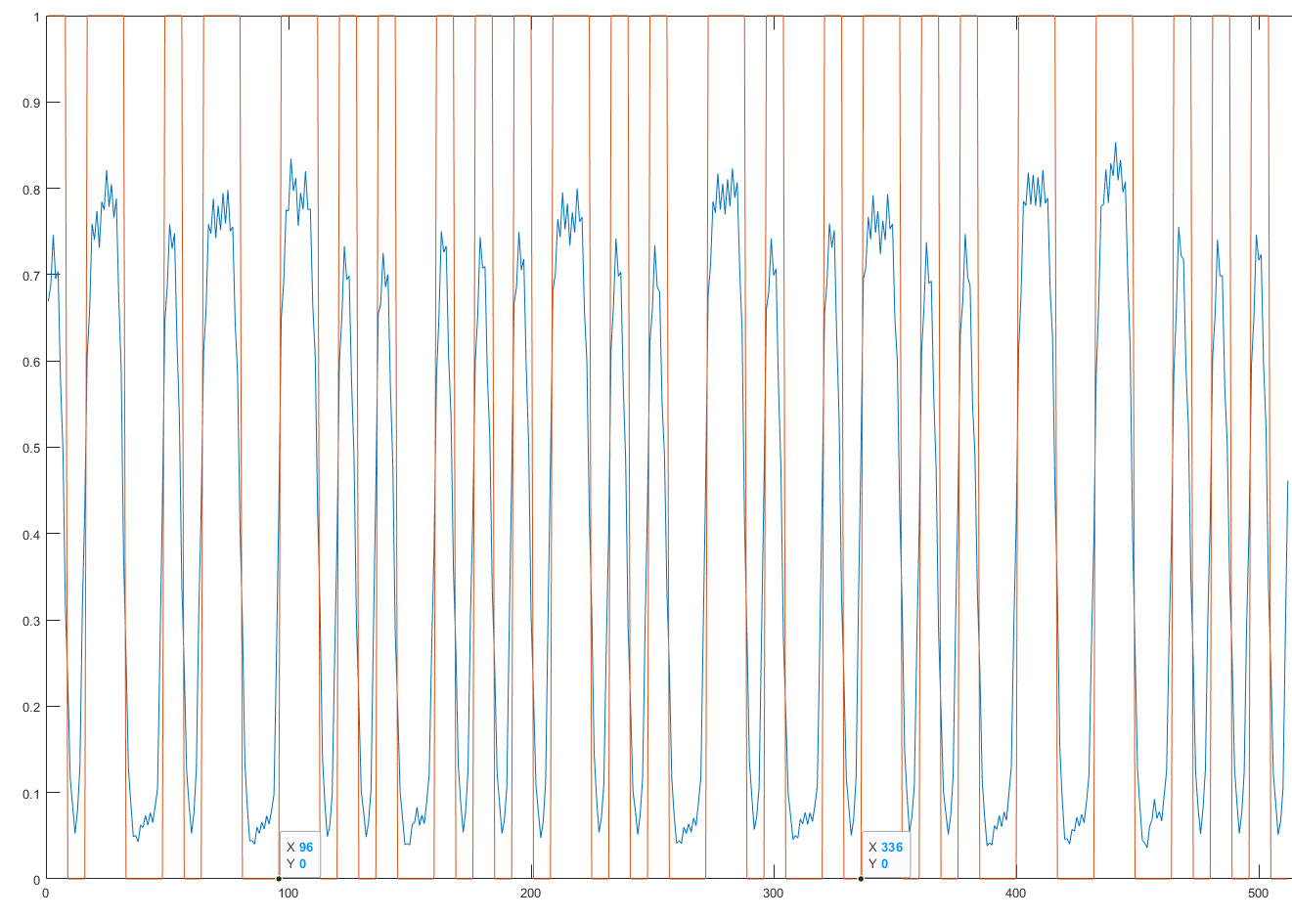
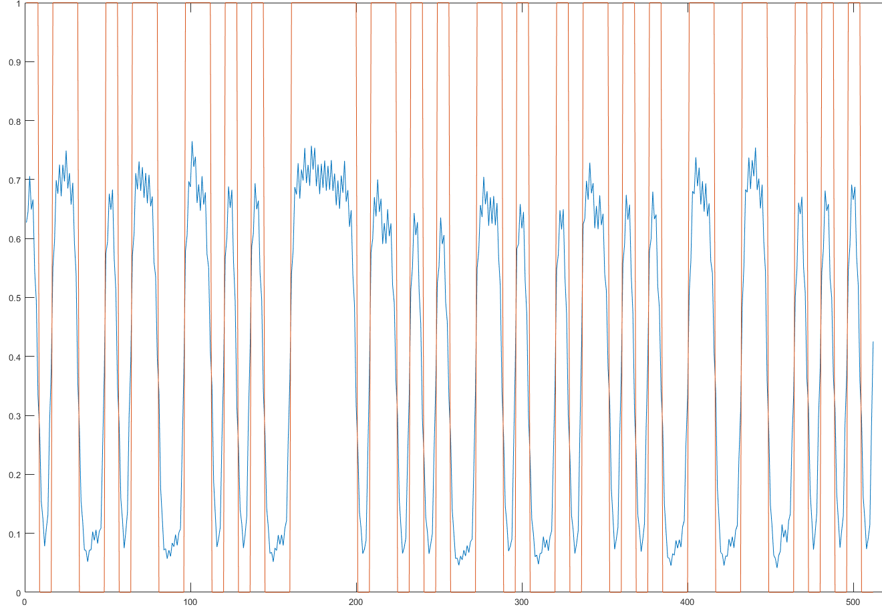
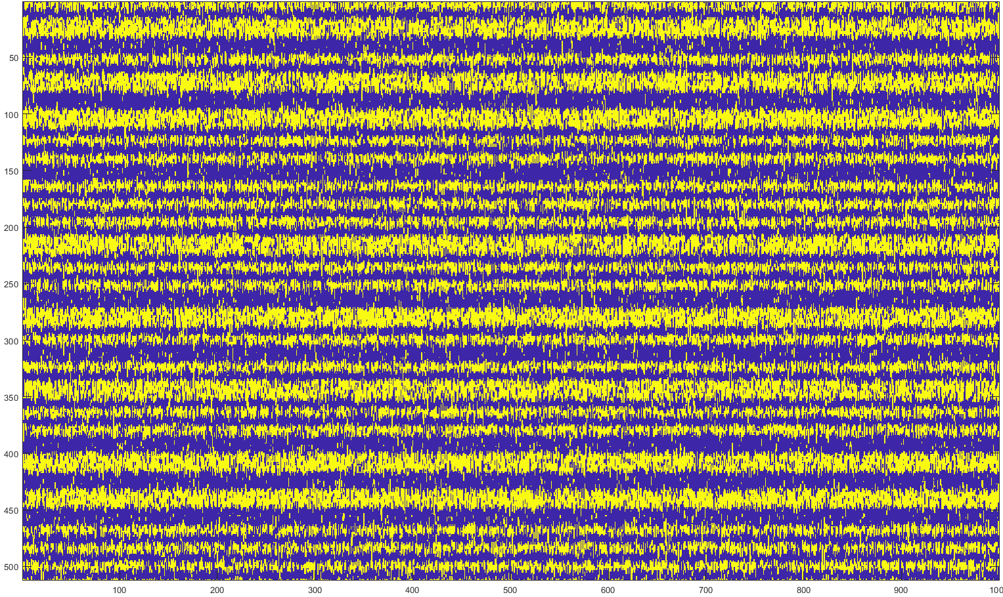
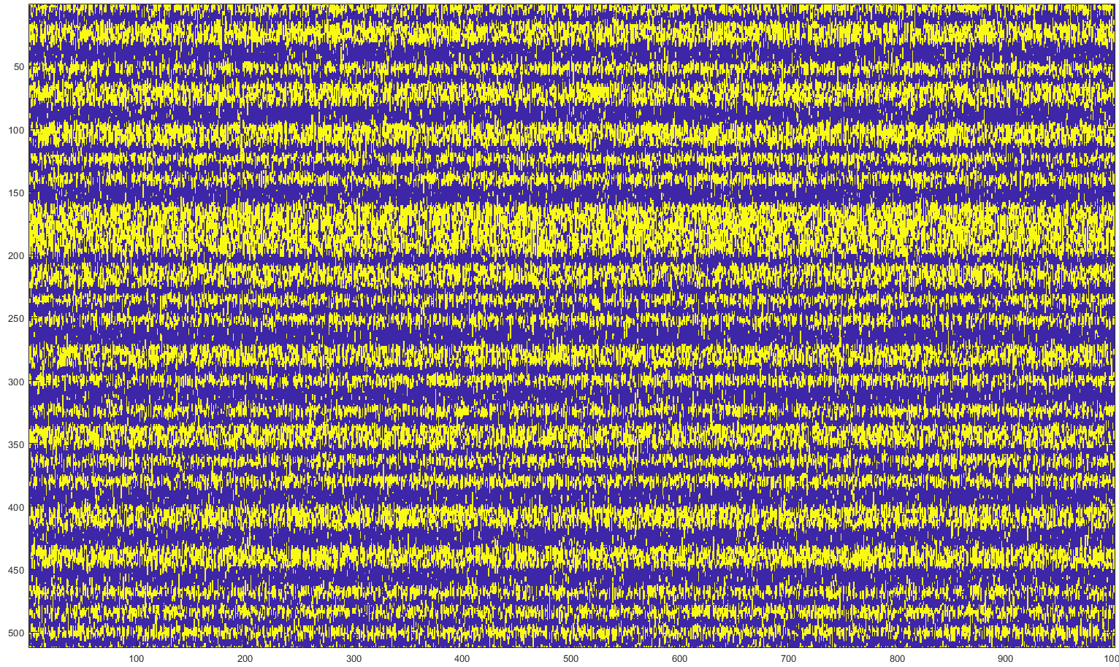
Tx Learning

Slide 10
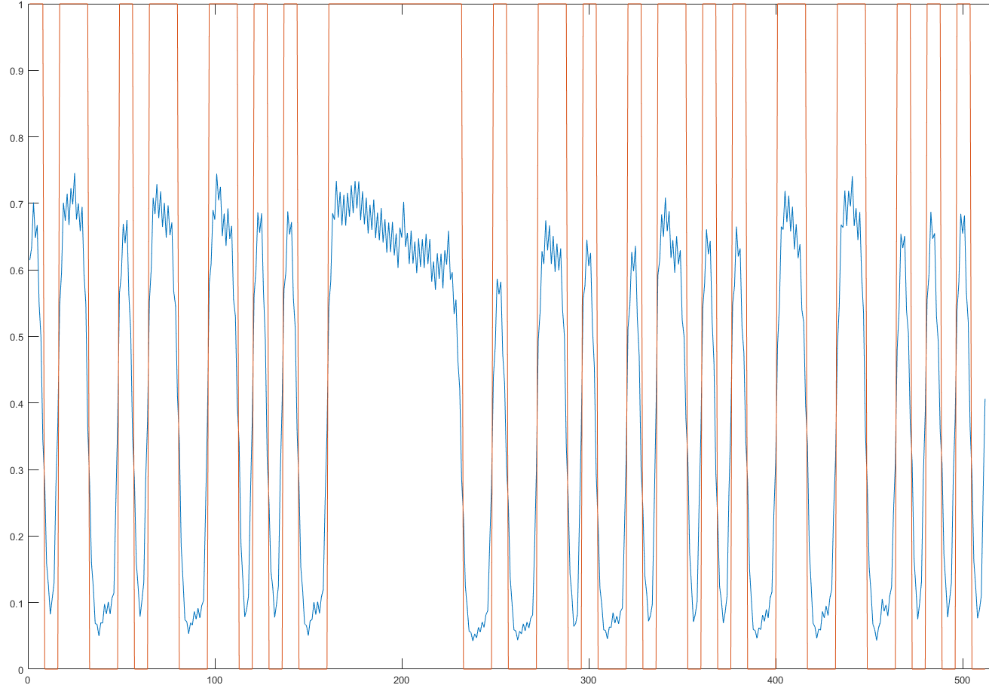
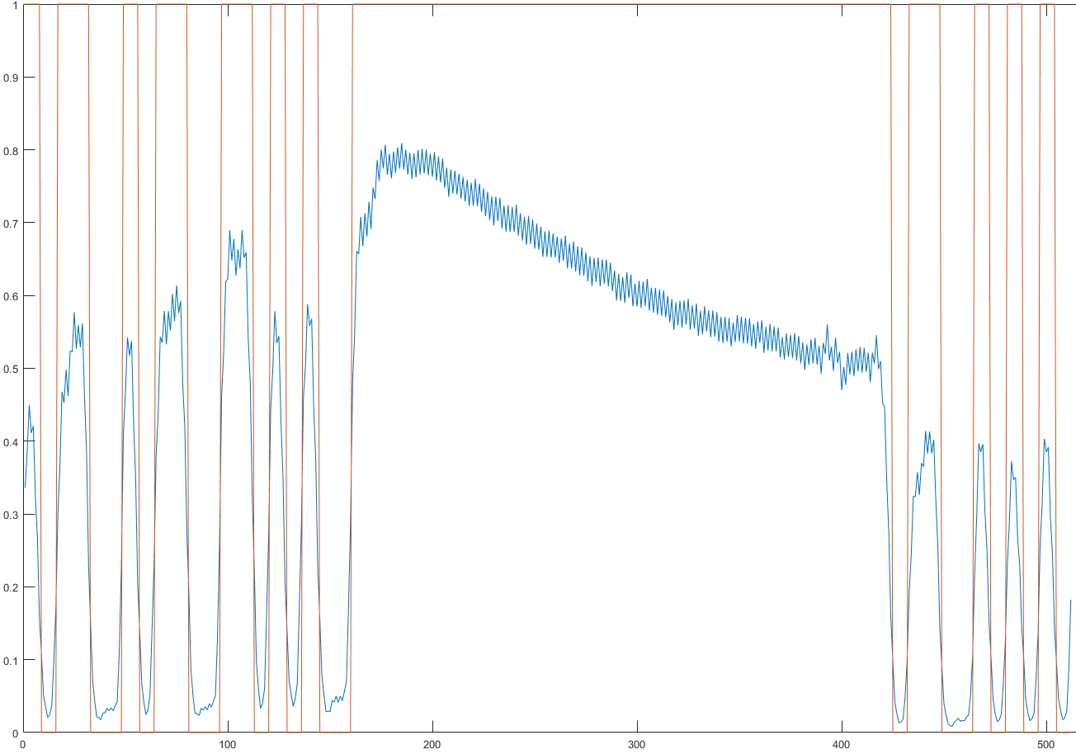
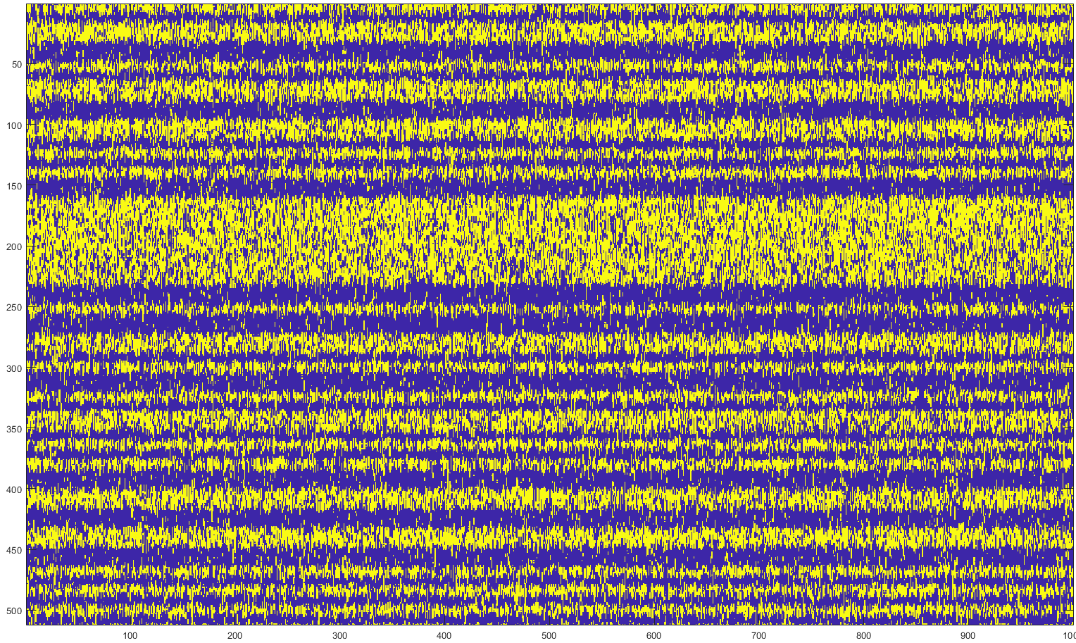
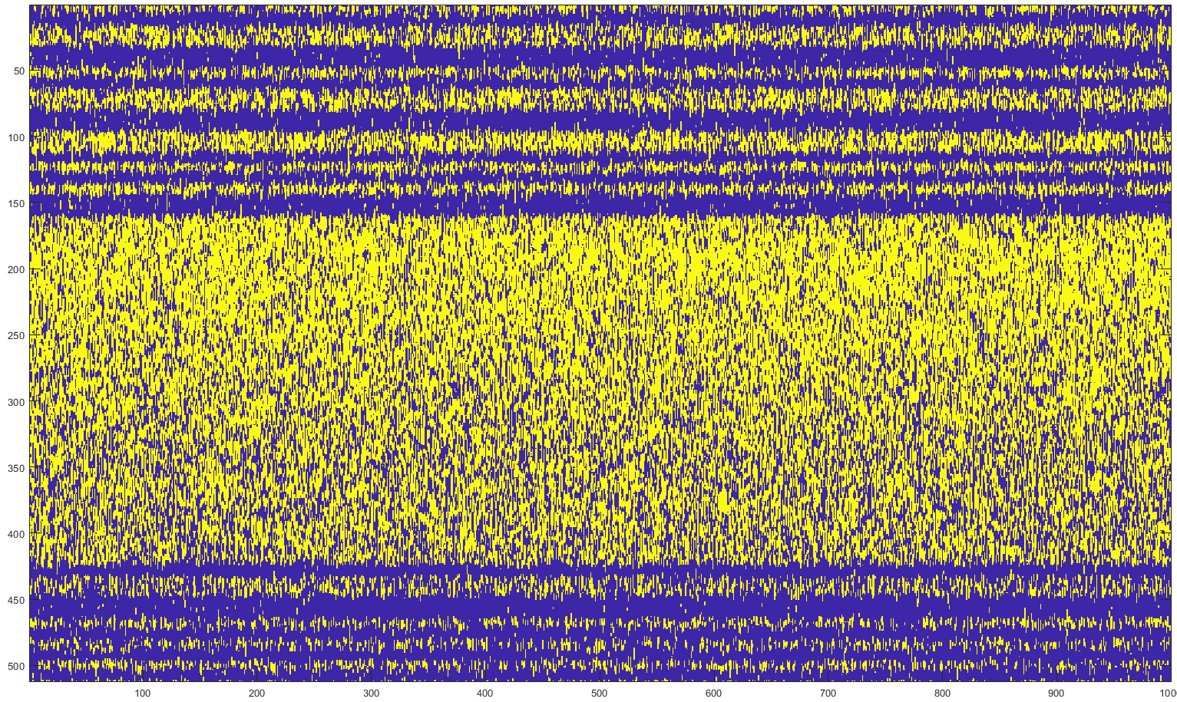
Tx Learning

Slide 11
Tx Learning
Emulate data?
Learn the emulation
Gan / Delta-encoder
Need large amount of data

